Slide 1





Database Programmability
Functions, Stored Procedures,
Triggers and Transactions
Databases
Basics
SoftUni Team
Technical Trainers
Software University
http://softuni.bg

Slide 2




Table of Contents
Functions
Stored Procedures
Transactions
ACID Model
Triggers
Database Security

Slide 3
Questions
sli.do #CSharpDB

Slide 4


User-Defined Functions
Definition, Usage, Syntax

Slide 5

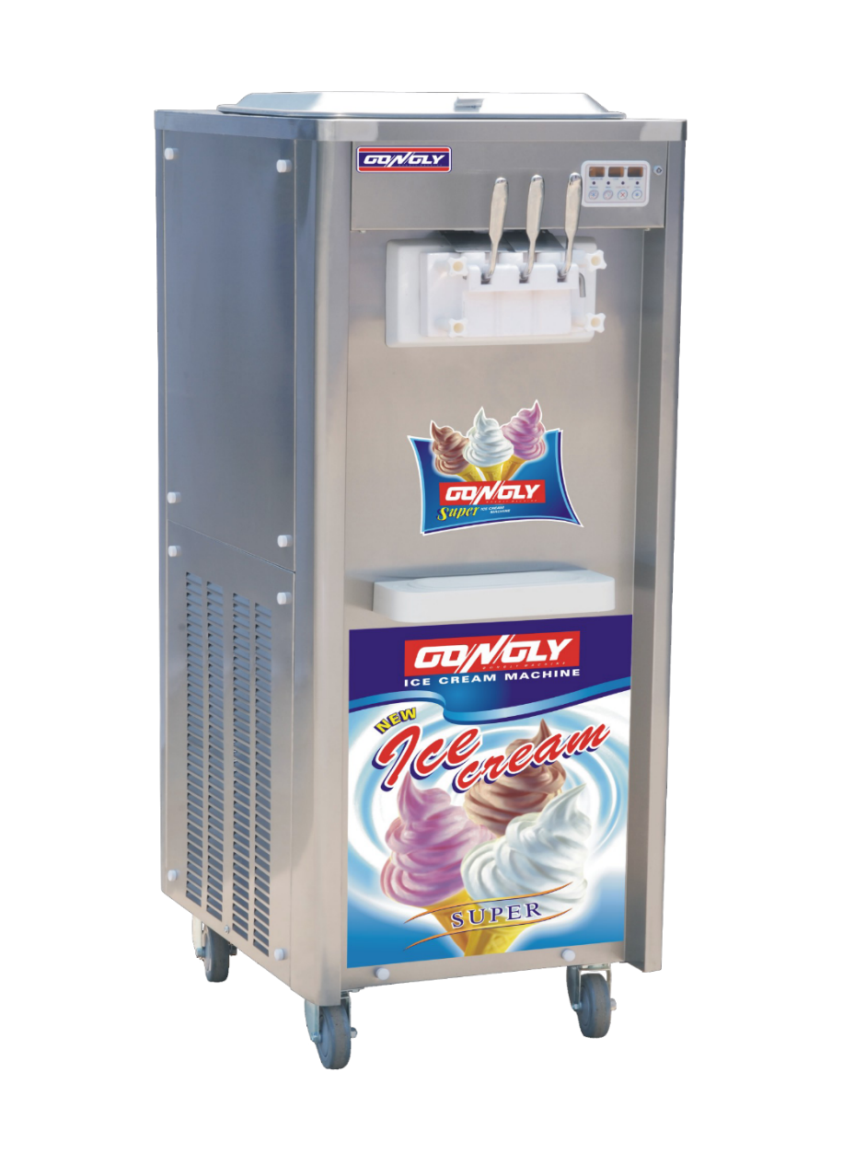





Functions: Basic Definition
At its core, a function receives input and produces output

Slide 6
Types of User-Defined Functions
Scalar functions (like SQRT(…)).
Similar to the built-in functions
Return a single value
Table-valued functions.
Similar to a view with parameters
Return a table as a result of single SELECT statement
Aggregate functions (like SUM(…))
Perform calculation over set of inputs values.
Defined through external .NET functions.

Slide 7
Create Functions
CREATE FUNCTION udf_ProjectDurationWeeks (@StartDate DATETIME, @EndDate DATETIME)
RETURNS INT
AS
BEGIN
DECLARE @projectWeeks INT;
IF(@EndDate IS NULL)
BEGIN
SET @EndDate = GETDATE()
END
SET @projectWeeks = DATEDIFF(WEEK, @StartDate, @EndDate)
RETURN @projectWeeks;
END
Function Name
Parameters
Return Type
Variable
IF Statement
Return Value

Slide 8
Execute Functions
Functions are called using schemaName.functionName
Call the Function
SELECT [ProjectID],
[StartDate],
[EndDate],
dbo.udf_ProjectDurationWeeks([StartDate],[EndDate])
AS ProjectWeeks
FROM [SoftUni].[dbo].[Projects]
ProjectID | StartDate | EndDate | ProjectWeeks
1 | 2016-09-01 | 2016-10-07 | 5
2 | 2016-10-01 | 2016-10-07 | 1
3 | 2015-10-07 | NULL | 52

Slide 9
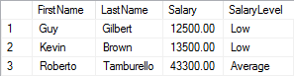

Problem: Salary Level Function
Write a function ufn_GetSalaryLevel(@salary MONEY) that receives salary of an employee and returns the level of the salary.
If salary is < 30000 return “Low”
If salary is between 30000 and 50000 (inclusive) return “Average”
If salary is > 50000 return “High”
Check your solution here: https://judge.softuni.bg/Contests/Practice/Index/302#4

Slide 10
Solution: Salary Level Function (1)
Input Parameters
Function Name
CREATE FUNCTION ufn_GetSalaryLevel(@salary INT)
RETURNS NVARCHAR(10)
AS
BEGIN
-- Function logic here.
END;
Return Type
Function Body
Check your solution here: https://judge.softuni.bg/Contests/Practice/Index/302#4

Slide 11
Solution: Salary Level Function (2)
Variable
DECLARE @salaryLevel VARCHAR(10)
IF (@salary < 30000)
SET @salaryLevel = 'Low'
ELSE IF(@salary >= 30000 AND @salary <= 50000)
SET @salaryLevel = 'Average'
ELSE
SET @salaryLevel = 'High'
RETURN @salaryLevel
IF Statement
Return Result
Check your solution here: https://judge.softuni.bg/Contests/Practice/Index/302#4

Slide 12

Stored Procedures

Slide 13
What are Stored Procedures?
Stored procedures are named sequences of T-SQL statements.
Encapsulate repetitive program logic
Can accept input parameters
Can return output results
Benefits of stored procedures
Share application logic
Improved performance
Reduced network traffic

Slide 14
Creating Stored Procedures
Syntax: CREATE PROCEDURE … AS …
Example:
USE SoftUni
GO
CREATE PROC dbo.usp_SelectEmployeesBySeniority
AS
SELECT *
FROM Employees
WHERE DATEDIFF(Year, HireDate, GETDATE()) > 5
GO
Procedure Name
Procedure Logic

Slide 15
Executing Stored Procedures
Executing a stored procedure by EXEC.
Executing a stored procedure within an INSERT statement.
EXEC usp_SelectEmployeesBySeniority
INSERT INTO Customers
EXEC usp_SelectEmployeesBySeniority

Slide 16
Altering Stored Procedures
Use the ALTER PROCEDURE statement
USE SoftUni
GO
ALTER PROC usp_SelectEmployeesBySeniority
AS
SELECT FirstName, LastName, HireDate,
DATEDIFF(Year, HireDate, GETDATE()) as Years
FROM Employees
WHERE DATEDIFF(Year, HireDate, GETDATE()) > 5
ORDER BY HireDate
GO
Procedure Name

Slide 17
Dropping Stored Procedures
DROP PROCEDURE
You could check if any objects depend on the stored procedure by executing the system stored procedure sp_depends
DROP PROC usp_SelectEmployeesBySeniority
EXEC sp_depends 'usp_SelectEmployeesBySeniority'

Slide 18

Stored Procedures
Using Parameters

Slide 19
Defining Parameterized Procedures
To define a parameterized procedure use the syntax:
Choose the parameter types carefully and provide appropriate default values
CREATE PROCEDURE usp_ProcedureName
[(@parameter1Name parameterType,
@parameter2Name parameterType,…)] AS
CREATE PROC usp_SelectEmployeesBySeniority(
@minYearsAtWork int = 5) AS
…

Slide 20
Parameterized Stored Procedures – Example
Procedure Name
CREATE PROC usp_SelectEmployeesBySeniority(@minYearsAtWork int = 5)
AS
SELECT FirstName, LastName, HireDate,
DATEDIFF(Year, HireDate, GETDATE()) as Years
FROM Employees
WHERE DATEDIFF(Year, HireDate, GETDATE()) > @minYearsAtWork
ORDER BY HireDate
GO
EXEC usp_SelectEmployeesBySeniority 10
EXEC usp_SelectEmployeesBySeniority
Procedure Logic
Usage

Slide 21
Passing Parameter Values
Passing values by parameter name
Passing values by position
EXEC usp_AddCustomer
@customerID = 'ALFKI',
@companyName = 'Alfreds Futterkiste',
@address = 'Obere Str. 57',
@city = 'Berlin',
@phone = '030-0074321'
EXEC usp_AddCustomer 'ALFKI2', 'Alfreds Futterkiste', 'Obere Str. 57', 'Berlin', '030-0074321'

Slide 22
Returning Values Using OUTPUT Parameters
CREATE PROCEDURE dbo.usp_AddNumbers
@firstNumber SMALLINT,
@secondNumber SMALLINT,
@result INT OUTPUT
AS
SET @result = @firstNumber + @secondNumber
GO
DECLARE @answer smallint
EXECUTE usp_AddNumbers 5, 6, @answer OUTPUT
SELECT 'The result is: ', @answer
-- The result is: 11
Creating procedure
Executing procedure
Display results

Slide 23
Problem: Employees with Three Projects
Create a procedure that assigns projects to employee.
If the employee has more than 3 projects, throw exception and rollback the changes
EmployeeID | ProjectID
1 | 5
1 | 6
2 | 6
2 | 7
2 | 8
Check your solution here: https://judge.softuni.bg/Contests/Practice/Index/302#8

Slide 24
Solution: Employees with Three Projects (1)
Procedure Name
CREATE PROCEDURE udp_AssignProject (@EmployeeID INT, @ProjectID INT)
AS
BEGIN
DECLARE @maxEmployeeProjectsCount INT = 3
DECLARE @employeeProjectsCount INT
SET @employeeProjectsCount =
(SELECT COUNT(*)
FROM [dbo].[EmployeesProjects] AS ep
WHERE ep.EmployeeId = @EmployeeID)
-- Transaction here.
END
Parameters
Declare Variables
Check your solution here: https://judge.softuni.bg/Contests/Practice/Index/302#10

Slide 25
Solution: Employees with Three Projects (2)
BEGIN TRAN
INSERT INTO [dbo].[EmployeesProjects] (EmployeeID, ProjectID) VALUES (@EmployeeID, @ProjectID)
IF(@employeeProjectsCount >= @maxEmployeeProjectsCount)
BEGIN
RAISERROR('The employee has too many projects!', 16, 1)
ROLLBACK
END
ELSE
COMMIT
Undo Changes
Throw Exception
Save Changes
Check your solution here: https://judge.softuni.bg/Contests/Practice/Index/302#8

Slide 26

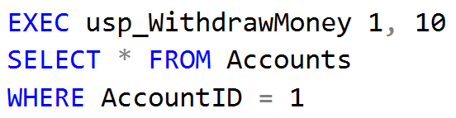
Problem: Withdraw Money
Create a stored procedure usp_WithdrawMoney (AccountId, moneyAmount) that operate in transactions.
Validate only if the account exists and if not, throw an exception.
Check your solution here: https://judge.softuni.bg/Contests/Practice/Index/302#14

Slide 27
Solution: Withdraw Money (1)
Procedure Name
CREATE PROCEDURE usp_WithdrawMoney @account INT, @moneyAmount MONEY
AS
BEGIN
-- Transaction logic goes here.
END
Parameters
Check your solution here: https://judge.softuni.bg/Contests/Practice/Index/302#14

Slide 28
Solution: Withdraw Money (2)
Update Balance
BEGIN TRANSACTION
UPDATE Accounts SET Balance = Balance - @moneyAmount
WHERE Id = @account
IF @@ROWCOUNT <> 1
BEGIN
ROLLBACK;
RAISERROR('Invalid account!', 16, 1)
RETURN
END
COMMIT
Rollback
Save changes
Check your solution here: https://judge.softuni.bg/Contests/Practice/Index/302#14

Slide 29
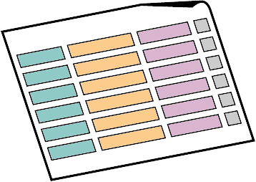


Transactions
Definition, Usage, ACID Model

Slide 30
Transactions
A Transaction is a sequence of actions (database operations) executed as a whole:
Either all of them complete successfully or none of them do
Examples:
A bank transfer from one account into another (withdrawal + deposit)
If either the withdrawal or the deposit fails the whole operation is cancelled

Slide 31

Transactions: Lifecycle (Rollback)
Read
Write
Durable starting state
Sequence of reads and writes
Durable,
consistent,
ending state
Write
Rollback

Slide 32

Transactions: Lifecycle (Commit)
Read
Write
Durable starting state
Sequence of reads and writes
Durable,
consistent,
ending state
Write
Commit

Slide 33
Transactions Behavior
Transactions guarantee the consistency and the integrity of the database
All changes in a transaction are temporary
Changes are persisted when COMMIT is executed
At any time, all changes can be canceled by ROLLBACK
All changes are persisted at once
As long as COMMIT is called

Slide 34

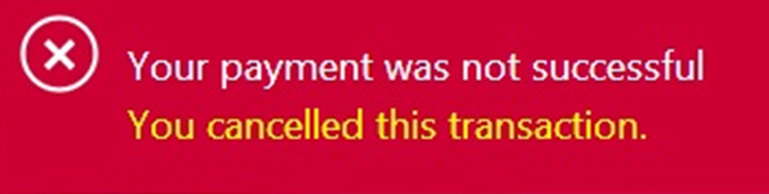
Transactions: What Can Go Wrong?
Some actions fail to complete
The application software or database server crashes
The user cancels the action while it’s in progress
Interference from another transaction.
What happens if several transfers run for the same account at the same time?
Notes:
Use transfer example, not cash machine for failing to complete

Slide 35


Checkpoints in games
DIE
Castle 1-1
Castle 1-2
Mario
SURVIVE

Slide 36

What are Transactions?
ROLLBACK
STATE 1
STATE 2
COMMIT
Queries
Notes:
Transaction is a sequence of actions (database operations) executed as a whole:
Either all of them complete successfully
Or none of the them
Example of transaction:
A bank transfer from one account into another (withdrawal + deposit)
If either the withdrawal or the deposit fails the whole operation is cancelled

Slide 37
Transactions Syntax
Start Transaction
Withdraw Money
BEGIN TRANSACTION
UPDATE Accounts SET Balance = Balance - @withdrawAmount
WHERE Id = @accountId
IF @@ROWCOUNT <> 1 – Didn’t affect exactly one row
BEGIN
ROLLBACK
RAISERROR('Invalid account!', 16, 1)
RETURN
END
COMMIT
Undo Changes
Save Changes
Notes:
Start a transaction
BEGIN TRANSACTION
Some RDBMS use implicit start, e.g. Oracle
Ending a transaction
COMMIT
Complete a successful transaction and persist all changes made
ROLLBACK
“Undo” changes from an aborted transaction
May be done automatically when failure occurs

Slide 38
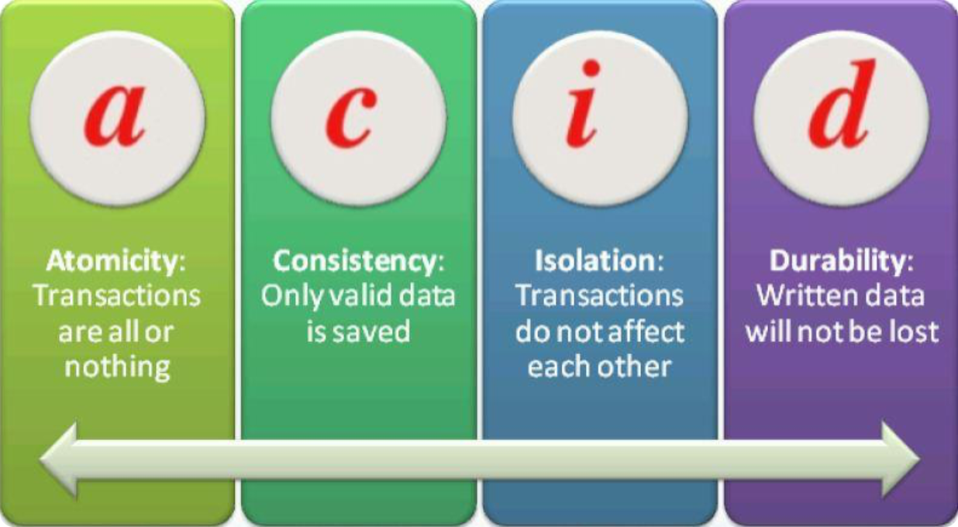
ACID Model
Solving problems before they arise

Slide 39


Transaction Properties
Modern DBMS servers have built-in transaction support
Implement “ACID” transactions.
E.g. MS SQL Server, Oracle, MySQL, …
ACID means:
Atomicity
Consistency
Isolation
Durability

Slide 40

Atomicity
Atomicity means that:
Transactions execute as a whole
DBMS guarantees that either all of the operations are performed or none of them
Example: Transferring funds between bank accounts
Either withdraw + deposit both succeed, or none of them do
In case of failure, the database stays unchanged

Slide 41

Consistency
Consistency means that:
The database has a legal state in both the transaction’s beginning and end
Only valid data will be written to the DB
Transaction cannot break the rules of the database
Primary keys, foreign keys, check constraints…
Consistency example:
Transaction cannot end with a duplicate primary key in a table

Slide 42

Isolation
Isolation means that:
Multiple transactions running at the same time do not impact each other’s execution
Transactions don’t see other transactions’ uncommitted changes
Isolation level defines how deep transactions isolate from one another
Isolation example:
If two or more people try to buy the last copy of a product, only one of them will succeed

Slide 43
Durability
Durability means that:
If a transaction is committed it becomes persistent
Cannot be lost or undone
Ensured by use of database transaction logs
Durability example:
After funds are transferred and committed the power supply at the DB server is lost
Transaction stays persistent (no data is lost)

Slide 44


Triggers

Slide 45
What Are Triggers?
Triggers are very much like stored procedures.
Called in case of specific event
We do not call triggers explicitly
Triggers are attached to a table.
Triggers are fired when a certain SQL statement is executed against the contents of the table.
Syntax:
AFTER INSERT/UPDATE/DELETE
INSTEAD OF INSERT/UPDATE/DELETE

Slide 46
After Trigger
AFTER Trigger is executed right after an event is fired
Query
Trigger
Event

Slide 47
Instead of Trigger
INSTEAD OF Trigger completely replaces an event action from happening
You can apply totally different logic
Event
Action

Slide 48
Instead of Trigger
INSTEAD OF Trigger completely replaces an event action from happening
You can apply totally different logic
Event
Action
Trigger

Slide 49
Events
There are three different events that can be applied within a trigger:
Events
Insert
Update
Delete

Slide 50
After Triggers
Defined by the keyword FOR
CREATE TRIGGER tr_TownsUpdate ON Towns FOR UPDATE
AS
IF (EXISTS(
SELECT * FROM inserted
WHERE Name IS NULL OR LEN(Name) = 0))
BEGIN
RAISERROR('Town name cannot be empty.', 16, 1)
ROLLBACK
RETURN
END
UPDATE Towns SET Name='' WHERE TownId=1
Causes an error

Slide 51
Instead Of Triggers
Defined by using INSTEAD OF
CREATE TABLE Accounts(
Username varchar(10) NOT NULL PRIMARY KEY,
[Password] varchar(20) NOT NULL,
Active char(1) NOT NULL DEFAULT 'Y’
)
CREATE TRIGGER tr_AccountsDelete ON Accounts
INSTEAD OF DELETE
AS
UPDATE a SET Active = 'N'
FROM Accounts AS a JOIN DELETED d
ON d.Username = a.Username
WHERE a.Active = 'Y'

Slide 52
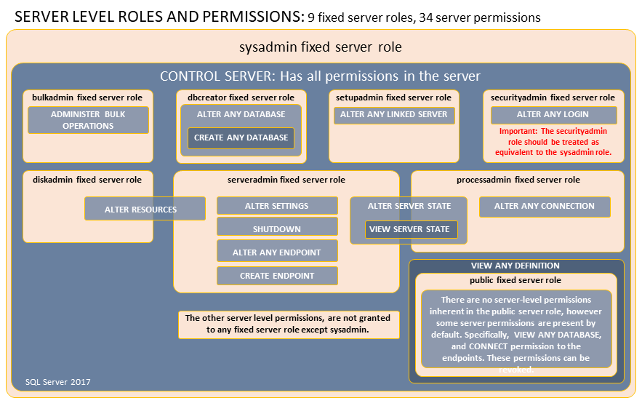

Database Security
Fixed Server Roles, Fixed Database Roles

Slide 53
Database Security: SQL Server
SQL Server has two layers of database security:
Fixed Server Roles
sysadmin, bulkadmin, dbcreator, securityadmin
Fixed Database Roles
db_owner, db_securityadmin, db_accessadmin
db_backupoperator, db_ddladmin
db_datareader/db_datawriter

Slide 54


Custom Roles
SQL Server lets us create custom roles
Collection of privileges (permissions)
Fine control over permissions
Can use one role for multiple users (groups)
Makes auditing operations easier

Slide 55
Custom Role Permissions
CONTROL SERVER/DATABASE
Gives all permissions on the server/database
TAKE OWNERSHIP
Enables the grantee to take ownership of a securable
VIEW CHANGE TRACKING
Manage change tracking on schemas and tables
VIEW DEFINITION
Enables the grantee to access metadata
EXECUTE
To run procedures, scalar and aggregate functions

Slide 56
Custom Role Permissions (2)
ALTER
Lets a role create, alter, and drop objects from the schema
REFERENCES
Lets the role create FOREIGN KEY constraints
SELECT/DELETE/INSERT/UPDATE
Grant access to CRUD Operations
Can be granted on database, schema and object level
Individual tables, views and columns can be targeted

Slide 57
Summary
Functions allow for complex calculations
Usually return a scalar value
Stored Procedures allow us to save time by
Shortening code
Simplifying complex tasks
CREATE FUNCTION f_ProcedureName RETURNS …
AS
…
CREATE PROC usp_ProcedureName AS …
Notes:
We can create user defined functions and stored procedures in SQL Server and we can easily execute them to save code repetition.
We can create triggers that apply a given behavior when some condition has occurred.
We can make transactions if we want to be sure that if all the behavior goes as planned, all the changes are made and in the other case, no changes are applied.

Slide 58
Summary
Transactions give our operations stability
Operation Integrity
Solving the concurrent operation problem
The ACID model is implemented in most RDBMS
Triggers apply a given behavior when a condition is hit
Gives us temporary INSERTED and DELETED tables
Security in SQL Server can be finely controlled
Using fixed server roles and fixed database roles
Custom roles control permissions even more finely
Notes:
We can create user defined functions and stored procedures in SQL Server and we can easily execute them to save code repetition.
We can create triggers that apply a given behavior when some condition has occurred.
We can make transactions if we want to be sure that if all the behavior goes as planned, all the changes are made and in the other case, no changes are applied.

Slide 59







Database Programmability
https://softuni.bg/courses/databases-basics-ms-sql-server

Slide 60






SoftUni Diamond Partners

Slide 61






SoftUni Diamond Partners

Slide 62
License
This course (slides, examples, demos, videos, homework, etc.) is licensed under the "Creative Commons Attribution-NonCommercial-ShareAlike 4.0 International" license
Attribution: this work may contain portions from
"Databases" course by Telerik Academy under CC-BY-NC-SA license

Slide 63





Trainings @ Software University (SoftUni)
Software University – High-Quality Education, Profession and Job for Software Developers
softuni.bg
Software University Foundation
http://softuni.foundation/
Software University @ Facebook
facebook.com/SoftwareUniversity
Software University Forums
forum.softuni.bg

